Slide 1


Overview of Azure IoT Suite

Slide 2
Elements of Azure IoT Suite
AZURE IoT Hub
Sensor
Data
GATEWAY/ DEVICE
Transport
SECURITY
RULES & ROUTING
REPORTS
SQL / NOSQL
DEVICE MGMT
ERP / LOB
SDK
AZURE IoT Suite
Notes:
The Microsoft Azure IoT Suite offers a solution to three key pillars;
Connect and scale with efficiency
Preconfigured solutions offer quick start-up provisioning to the most common IoT scenario requirements.
Heterogeneous agents libraries, documentation and SDK’s allow for OS selection and cross platform, multi language support. Easily flash devices and create custom agents using open source libraries.
Connect and control devices easily, handling device authentication and secure two way communication.
Analyze and act on new data
Set thresholds, alert limits and values and alarm jobs while processing big data.
Implement predictive analytics and algorithms across historical and real time data for a variety of purposes.
Visualize big data on dashboards or create reports for business decision makers.
Integrate and transform business processes
Integrate alarms, real time processes and elevate attention within new or existing line of business applications.
Broadcast notifications and commands to devices or personnel; utilize geographic or other custom features to target audiences.
c) Make dashboards and data available but control security and access to devices, thresholds and alert configurations.

Slide 3
Overview of Azure IoT Hub

Slide 4
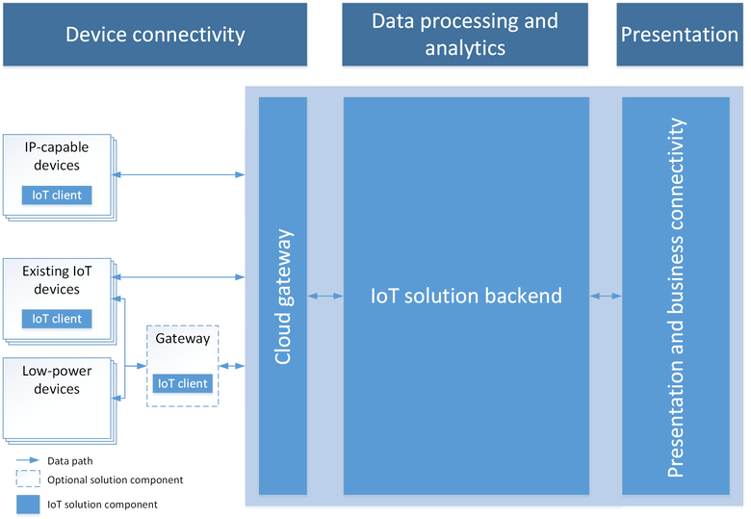
IOT Solution Architecture
Notes:
Microsoft Azure IoT Hub provides capabilities for securely connecting, provisioning, updating and sending commands to devices. IoT Hub enables companies to control millions of IoT assets running on a broad set of operating systems and protocols to jumpstart their Internet of Things projects.
IoT Hub enables companies to:
Establish reliable bi-directional communication with IoT assets, even if they are intermittently connected, so companies can analyze incoming telemetry data and send commands and notifications as needed.
Enhance security of IoT solutions by leveraging per-device authentication to communicate with devices with the appropriate credentials.
Revoke access rights to specific devices, if needed, to maintain the integrity of the system.

Slide 5
Introducing Microsoft Azure IoT Hub
IoT Hub is available as a stand-alone service or as one of the services used in the new Azure IoT Suite
Azure IoT Hub is designed to connect your devices to Azure. It supports
Millions of simultaneously connected devices
Per-device authentication
High throughput data ingestion
Reliable command and control
Notes:
Microsoft Azure IoT Hub provides capabilities for securely connecting, provisioning, updating and sending commands to devices. IoT Hub enables companies to control millions of IoT assets running on a broad set of operating systems and protocols to jumpstart their Internet of Things projects.
IoT Hub enables companies to:
Establish reliable bi-directional communication with IoT assets, even if they are intermittently connected, so companies can analyze incoming telemetry data and send commands and notifications as needed.
Enhance security of IoT solutions by leveraging per-device authentication to communicate with devices with the appropriate credentials.
Revoke access rights to specific devices, if needed, to maintain the integrity of the system.

Slide 6
IOT Solution Architecture
IoT Hub
Event processing and insight
(e.g. hot and cold paths)
1
0
1
1
0
0
1
1
0
0
0
1
1
0
1
0
1
0
1
0
0
1
1
0
IP-capable
0
1
1
0
1
0
Cloud protocol
gateway
0
1
1
1
Field gateway
Device business logic,
Connectivity monitoring
None IP-devices
Application
device provisioning and management
field
cloud
Notes:
Connecting your devices is the 1st challenge that you have when creating an IoT solution. There is a vast variety of devices you may want to connect. Some are internet capable and in that case you can connect them directly to Azure service (eg: IoT Hub) or you can use your own Cloud protocol gateway in case the device you are trying to connect does not have a protocol supported by IoT Hub (at this time AMQP or HTP). However, some devices are not internet capable and those devices need a field gateway to connect to the cloud. This gateway can do many things – not only connectivity and protocol translation but on the application back end side, one of the most important use cases is telemetry. You usually want to have an event processing and insight pipeline and IoT Hub will allow you to get a feed from the devices and events easily.
The 2nd big component that IoT solutions have with cloud is device big logic that takes care of interactive scenarios of your solutions – think about opening your car door or adjusting your home thermostat from your smart phone or sending a command to a device to update a piece of firmware.
Finally IoT Hub has to know which devices have to connect and which devices are present for IoT solution. For this purpose it has to interact with the visioning and management component which is the component that makes sure that the devices are on-boarded and de-provisioned correctly from your own IoT solutions.

Slide 7
Why use IoT Hub?
Device-to-cloud messaging
Cloud-to-device messaging
Scale up to millions of simultaneously connected devices
Device authentication & security
Service-facing device connectivity monitoring
IoT protocols, device resource optimization
Notes:
You might be wondering why you need IoT Hub in the first place. After all there are service in Azure that allows you to perform the device to cloud messaging – for instance using service bus.
IoT Hub in addition to communication patterns adds other value propositions to your IoT solutions. It scales up to millions of simultaneously connected devices you do not have to scale those services on your own. These communication patterns will scale with you just by increasing the # of units in your IoT deployment.
IoT Hub supports per device authentication and security. Per device authentication is fundamental because you want to have fine grain control on which devices access your solution and you want to make sure that you are sending commands to the right devices. This per device authentication and per device identity is embedded and designed into the communication pattern in the device to cloud messaging and cloud to device messaging.
There is also service facing monitoring. IoT solutions usually have the problem that devices cannot be reached without a cloud connection. Mostly it requires someone physically going to the device location to deliver maintenance on it. Since this is the case, it is very important to have monitoring on the status of each and every piece of communication.
Finally, IoT Hub supports many IoT protocols and is designed to support constrained devices, where device is retrained in networking resources, power resources or computational resources.
Of course, your IoT solution might need different communication patterns. You can thinking about uploading or downloading files or using real time proxy strategy like an HTP or WEB API. These patterns while they are not currently supported in IoT Hub do benefit from IoT Hub in many ways and we do provide guidance on how to implement them.

Slide 8

Communication Scenarios
Telemetry
Inquiries
Commands
Notifications
Information flowing from a device to other systems for conveying status of device and environment
Requests from devices looking to gather required information or to initiate activities
Commands from other systems to a device or a group of devices to perform specific activities
Information flowing from other systems to a device (group) for conveying status changes

Slide 9
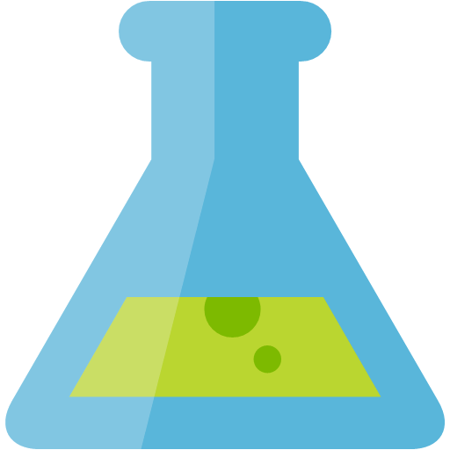

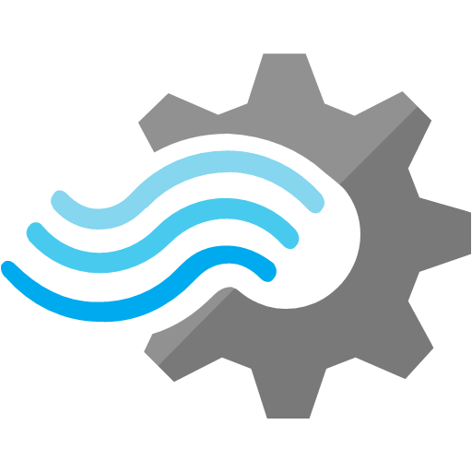
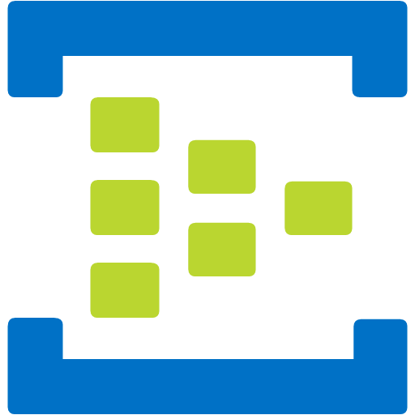
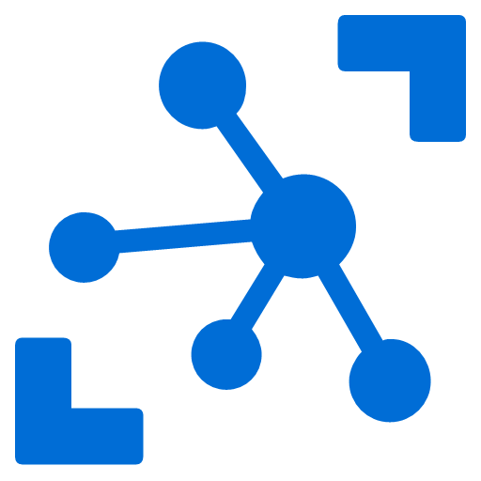
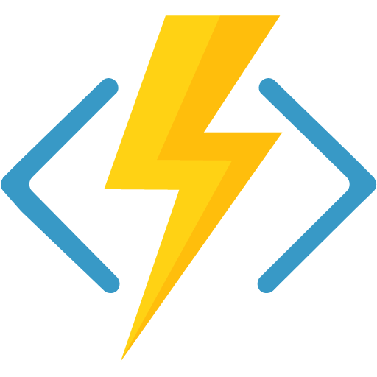

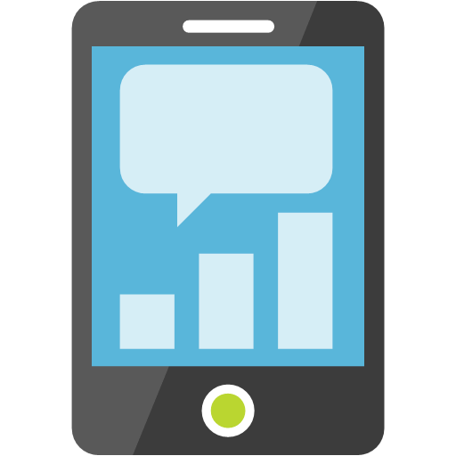

Inside the IoT Hub
Events
Devices
IoT Hub
Machine Learning
Cosmo DB
Stream Analytics
Messaging
Function App
Logic App
Custom

Slide 10
Information Exchange Patterns Basics of IoT Communication
Events
Messaging
Methods
State
Massive stream of information. Managed outside the IoT Hub
C2D communication using a pub/sub pattern using topics & subscriptions
Devices exposes methods that can called from a external applications using a request/response pattern
Device state is exchanged using device-twin configuration stored in the IoT Hub.

Slide 11
Device Management – Device Twins
JSON documents to store device state information (metadata, configurations, and conditions).
Use device twins to:
Store device metadata from your solution back end.
Report current state information such as available capabilities and conditions (for example, the connectivity method used) from your device app.
Synchronize the state of long-running workflows (such as firmware and configuration updates) between a device app and a back-end app.
Query your device metadata, configuration, or state.
Notes:
IoT Hub provides a vast variety of SDKs for devices and services. There are 2 different flavors – ones that are device facing and target at device and field gateways. These provide the best variety for platforms and languages. The there are ones that are service facing and targeted at application back ends and cloud gateways and support many languages.

Slide 12
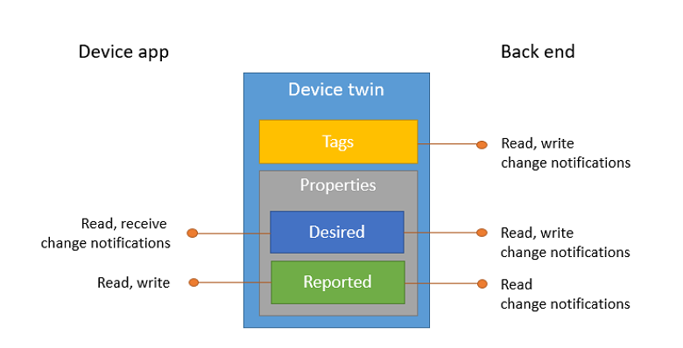
Device Management – Device Twins
Device twins contain:
tags, device metadata accessible only by the solution back end;
desired properties, modifiable by the solution back end and observable by the device app
reported properties, modifiable by the device app and readable by the solution back end.
Notes:
IoT Hub provides a vast variety of SDKs for devices and services. There are 2 different flavors – ones that are device facing and target at device and field gateways. These provide the best variety for platforms and languages. The there are ones that are service facing and targeted at application back ends and cloud gateways and support many languages.

Slide 13
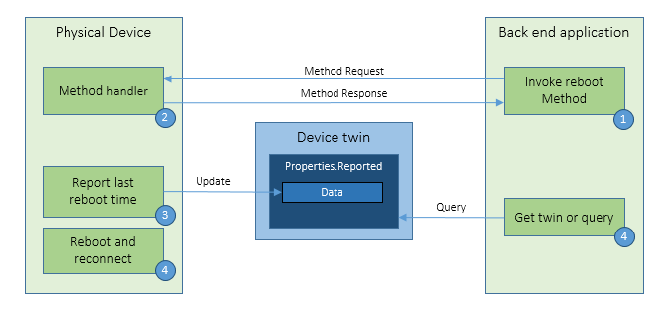
Device Management Patterns - Reboot
Notes:
Reboot - The back-end app informs the device through a direct method that it has initiated a reboot. The device uses the reported properties to update the reboot status of the device.

Slide 14
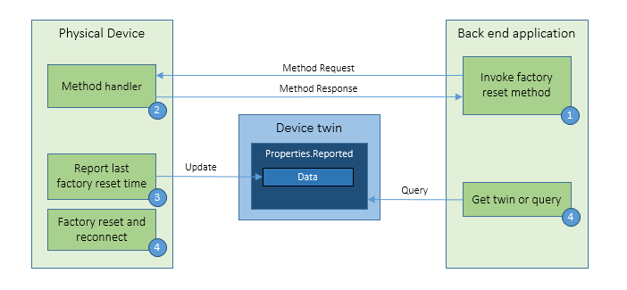
Device Management Patterns – Factory Reset
Notes:
Factory Reset - The back-end app informs the device through a direct method that it has initiated a factory reset. The device uses the reported properties to update the factory reset status of the device.

Slide 15
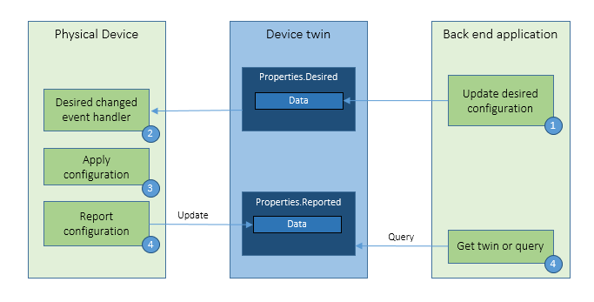
Device Management Patterns – Configuration
Notes:
Configuration - The back-end app uses the desired properties to configure software running on the device. The device uses the reported properties to update configuration status of the device.

Slide 16
Communication Patterns – Device to Cloud
 | Device to Cloud Messages | Reported Properties | File Uploads
Scenario | Telemetry time-series, alerts | Available capabilities, state (e.g. Wifi or cellular), long-runnign workflows (updates) | Media files
Storage and Retrieval | Temporarily stored by IOT Hub (7 days), Squential read | Stored in device twins, retrieved using queries | Azure storage account
Size | 256 KB | 8 KB | Azure Blob Storage
Frequency | High | Medium | Low
Protocol | All protocols | MQTT | All Protocols
Notes:
IoT Hub provides a vast variety of SDKs for devices and services. There are 2 different flavors – ones that are device facing and target at device and field gateways. These provide the best variety for platforms and languages. The there are ones that are service facing and targeted at application back ends and cloud gateways and support many languages.

Slide 17
Communication Patterns – Cloud to Device
 | Direct Methods | Desired Properties | Cloud to Device messages
Scenario | Immediate confirmation (turn on/off a sensor) | Long running commands to put device in certain state (change interval) | One way notification to device app
Data flow | Two-way (from device app to solution backend) | One-way (device app receives notification with property change) | One-way (device app receieves the message)
Durability | Disconnected devices missed | Preserved in device twin (disconnected device reads upon reconnection) | 48 hours
Target | Single device (deviceId), Jobs for broadcast | Single device (deviceId), Jobs for broadcast | Single device (deviceId)
Frequency | High | Medium | Low
Size | 8 KB (request & response) | 8 KB | 64 KB
Notes:
IoT Hub provides a vast variety of SDKs for devices and services. There are 2 different flavors – ones that are device facing and target at device and field gateways. These provide the best variety for platforms and languages. The there are ones that are service facing and targeted at application back ends and cloud gateways and support many languages.

Slide 18
IoT Hub endpoints
Your IoT Hub
Event processing
(hot and cold path)
device
Device id
D2C receive endpoint
D2C send endpoint
Device business logic,
Connectivity monitoring
C2D queue
endpoint
1
0
1
1
0
0
1
C2D send endpoint
1
0
0
0
1
1
0
1
0
1
0
1
0
0
1
1
0
0
1
1
0
1
0
0
1
1
1
Field GW /
Cloud GW
Msg feedback and monitoring endpoint
Device …
Device …
Device provisioning and management
Device identity management
Device …
IoT Hub management
Notes:
When you provision an IoT Hub from the Azure Management portal, you will create your own instance of IoT Hub. This instance exposes a set of conceptual endpoints to access its functionalities.
There are two endpoints for each device: one to send D2C msgs, one to receive C2D msgs.
Devices can connect two both endpoints over the same connection.
Field Gateways and Cloud Gateways are able to represent multiple devices by simultaneously connecting to D2C and C2D endpoints for many devices at the same time.
On the app back-end side, the D2C receive endpoint is used by the event processing pipeline (ASA, Storm, custom, …), and by the device runtime logic component, which handles requests and command responses that come from devices.
The device runtime logic component also uses the C2D send endpoint to send notifications and commands to devices.
It also uses the msg feedback and monitoring endpoint. This is critical for IoT solutions where devices are reachable only through IoT Hub. In these very common scenarios, any problem on the connectivity between device and IoT Hub cannot just be reported as errors back to the device, but also to the app back-end in the form of events on this feedback endpoint. This makes possible the kind of monitoring that is required to achieve high operability of an IoT solution.
In addition to these runtime endpoint, IoT Hub also has a device identity management endpoint that is used by your solution’s device provisioning and mgmt component.
Finally, an IoT Hub Manage endpoint is used to set security, functional, performance parameters.

Slide 19
Azure IoT SDKs
Device-facing
For devices and field gateway
Platforms
RTOS (FreeRTOS)
Linux (Ubuntu, Debian, Fedora, Raspbian, Angstrom)
Windows 7/8/10
ARM mbed
Android
Languages
C/C++, Java, C#, JavaScript, Python
Service-facing
For back-ends and cloud gateway
Languages
.NET C#
Java
Node
Notes:
IoT Hub provides a vast variety of SDKs for devices and services. There are 2 different flavors – ones that are device facing and target at device and field gateways. These provide the best variety for platforms and languages. The there are ones that are service facing and targeted at application back ends and cloud gateways and support many languages.

Slide 20














Azure IoT Services
Devices | Device Connectivity | Storage | Analytics | Presentation & Action
 | Event Hubs | SQL Database | Machine Learning | App Service
 | Service Bus | Table/Blob Storage | Stream Analytics | Power BI
 | External Data Sources | DocumentDB | HDInsight | Notification Hubs
 |  | External Data Sources | Data Factory | Mobile Services
 |  |  |  | BizTalk Services
{ }
Notes:
IoT Hub provides a vast variety of SDKs for devices and services. There are 2 different flavors – ones that are device facing and target at device and field gateways. These provide the best variety for platforms and languages. The there are ones that are service facing and targeted at application back ends and cloud gateways and support many languages.

Slide 21
A sample scenario
Simulated wind turbine
Emits telemetry every second
State machine (Starting → Started → Stopping → Stopped)
Provision device
Device registry to query devices and track provisioning
Device identity and key stored in IoT hub
Device emits telemetry
Event processor receives telemetry and updates portal visualization
Send commands
Portal sends commands to devices
Command lifecycle is stored in device registry
IoT Hub
Event Processor
Device id
D2C receive endpoint
D2C send endpoint
C2D queue
endpoint
Device registry
Command store
C2D send endpoint
Device …
Device …
Portal
IoT Hub management
Device …
Notes:
The sample scenario used in the demo.
A console simulator represent an individual wind turbine, emitting telemetry every second.
Also it simulates wind turbine start ad stop lifecycle, controlled by the cloud.
The main portions of the demo are:
provisioning: a simple portal app provisions devices with a device registry (implemented in a DocDB in the demo) and the hub identity registry.
The previous step enables a device simulator to connect to the hub and start emitting telemetry and listen for commands.
Telemetry is received by a console app running an Event Processor Host, which updates the portal with the latest telemetry values.
From the portal we can then send commands, which are recorded in a command store (to keep track of the status of each command).
The simulators reacts to the commands and send responses back through the D2C stream. The event processor then can distinguish command responses from telemetry messages and update the command store accordingly.

Slide 22
IoT Hub helps connect your devices to Azure
Millions of simultaneously connected devices
Per-device authentication
High throughput D2C messaging
Reliable C2D messaging
Notes:
Azure IoT Hub supports millions of simultaneously connected devices. It supports per device authentication and identities which makes sure that your device connectivity is secured. It supports high throughput device to cloud messaging and reliable cloud to device messaging and it was extensive support on the device and service SDKs.
You can try Azure IoT Hub for free now on Azure.com.

Slide 23
Preconfigured solutions

Slide 24
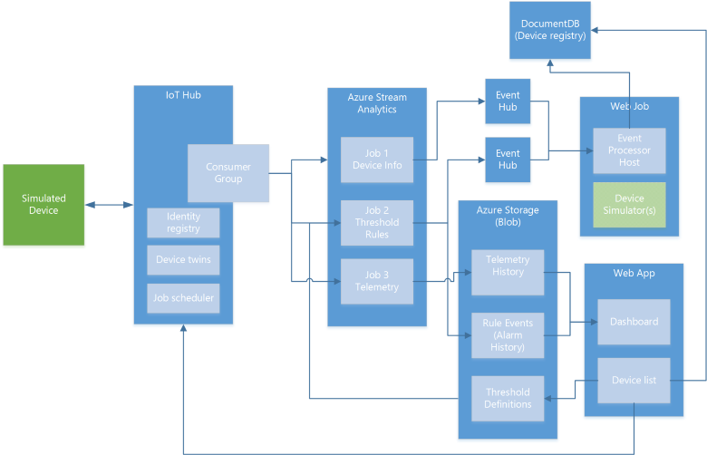
Remote monitoring preconfigured solution
Notes:
How does it work? As mentioned; the solution is a combination of multiple back-end components. This architecture diagram shows the individual Microsoft products and services that are utilized.
Reference Architecture for Remote Monitoring solution, what products are used and why? ->
Provision simulated devices with a C# device emulator running .Net. Create agents for Linux, iOS, Android and other platforms with C and Java language support.
IoT Hub manages the two way communication between cloud and device and creates a secure command and control channel.
Azure Stream Analytics creates and manages jobs to recognize threshold values or detect alarm triggers, sending this information where it needs to be escalated.
Event Hub is queried by a web job running an event processor host to determine where and alarm or alert needs to be pushed – such as sending an alert to dashboard for a human operator to take action.
Logic Apps are used to create more complex work loads and integrate into line of business and other proprietary applications.
Document DB stores all the metadata and device properties for each connected device.
Blobs store telemetry information and telemetry data. Other tools such as Azure Machine Learning and PowerBI can access this information for data visualization or processing advanced analytics.
Webapp – Dashboard code is available in Github allowing it to be fully customized by the user to align with a scenario or be relevant for an enterprise application.
Azure Active Directory controls user ID’s and access, allowing the service to be shared with relevant decision makers within the business but restrict access to certain controls or devices.
PowerBI is used for both open-source embedded components within the dashboard and also for complex external analytics of trends and patterns across all stored data.

Slide 25
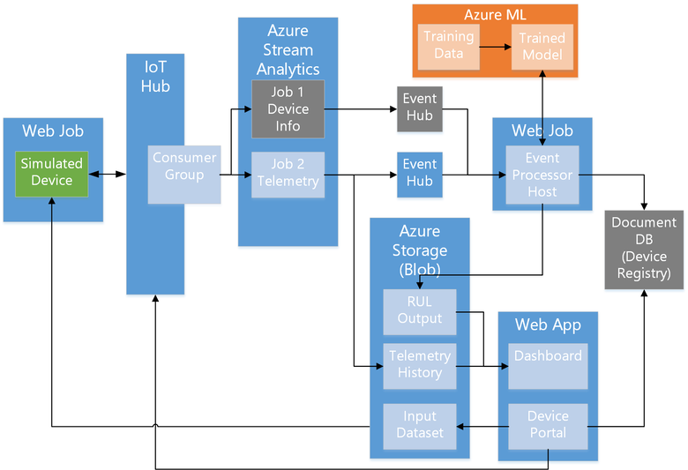
Predictive maintenance solution
Notes:
How does it work? As mentioned; the solution is a combination of multiple back-end components. This architecture diagram shows the individual Microsoft products and services that are utilized.
Reference Architecture for Remote Monitoring solution, what products are used and why? ->
Provision simulated devices with a C# device emulator running .Net. Create agents for Linux, iOS, Android and other platforms with C and Java language support.
IoT Hub manages the two way communication between cloud and device and creates a secure command and control channel.
Azure Stream Analytics creates and manages jobs to recognize threshold values or detect alarm triggers, sending this information where it needs to be escalated.
Event Hub is queried by a web job running an event processor host to determine where and alarm or alert needs to be pushed – such as sending an alert to dashboard for a human operator to take action.
Logic Apps are used to create more complex work loads and integrate into line of business and other proprietary applications.
Document DB stores all the metadata and device properties for each connected device.
Blobs store telemetry information and telemetry data. Other tools such as Azure Machine Learning and PowerBI can access this information for data visualization or processing advanced analytics.
Webapp – Dashboard code is available in Github allowing it to be fully customized by the user to align with a scenario or be relevant for an enterprise application.
Azure Active Directory controls user ID’s and access, allowing the service to be shared with relevant decision makers within the business but restrict access to certain controls or devices.
PowerBI is used for both open-source embedded components within the dashboard and also for complex external analytics of trends and patterns across all stored data.

Slide 26
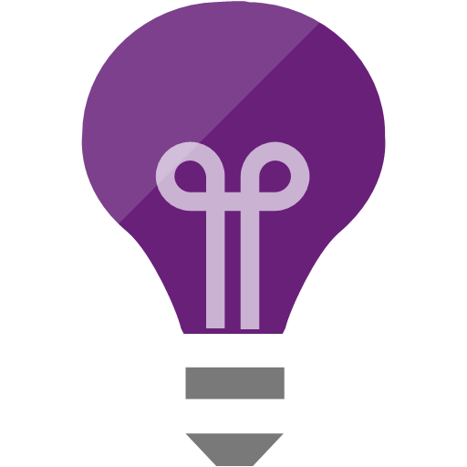
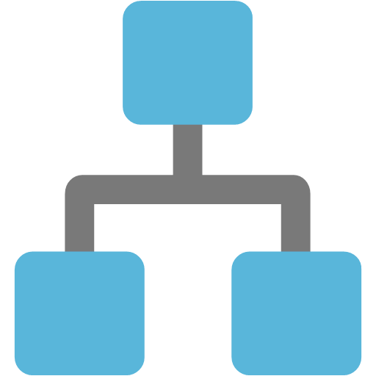
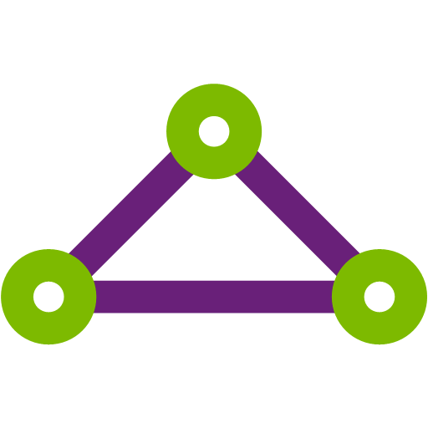
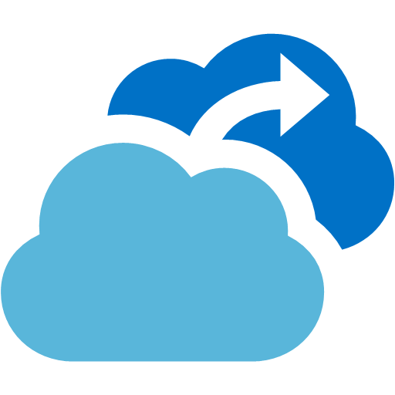
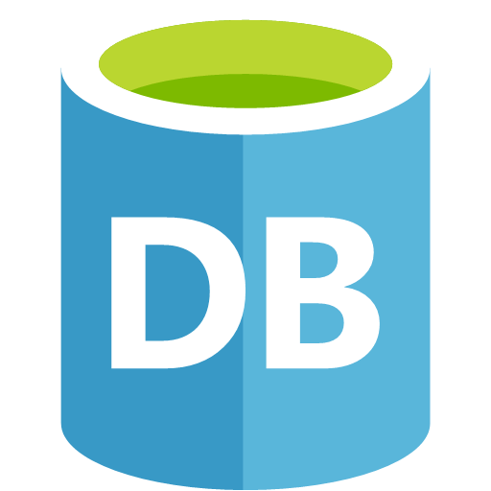
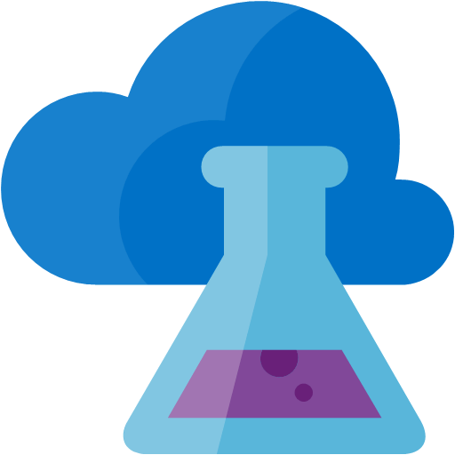


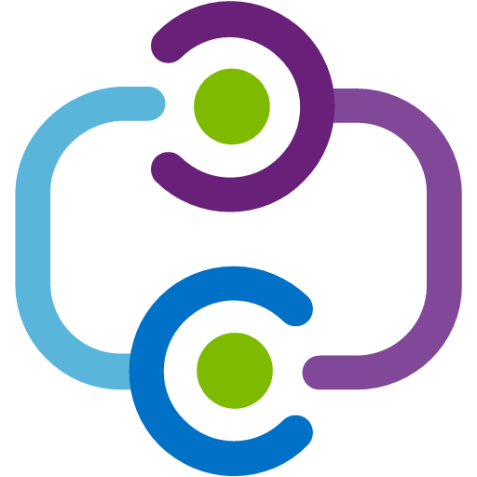
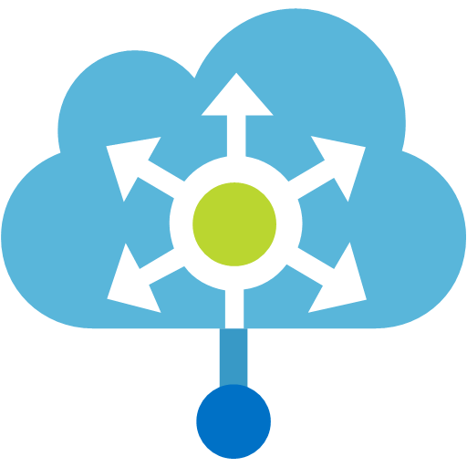

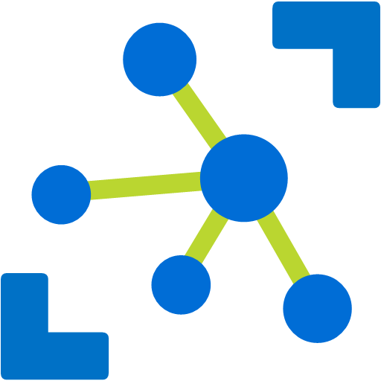
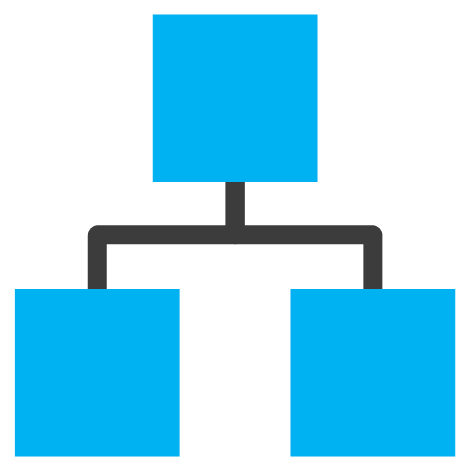
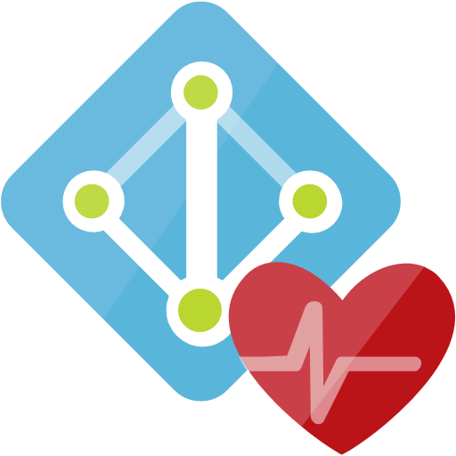
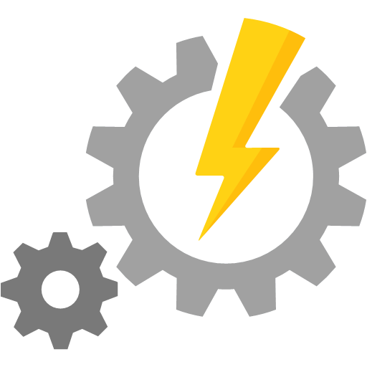
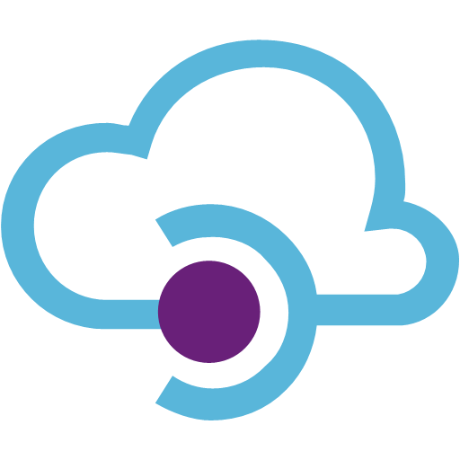
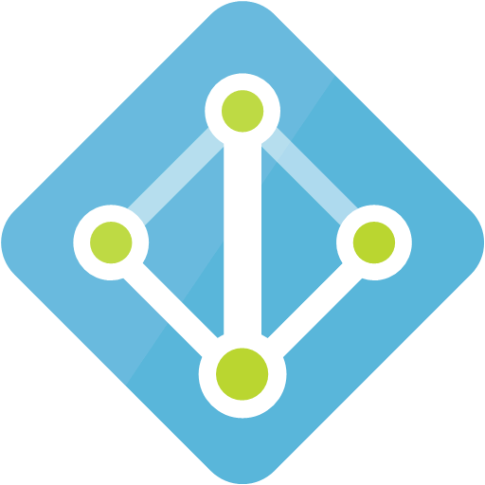
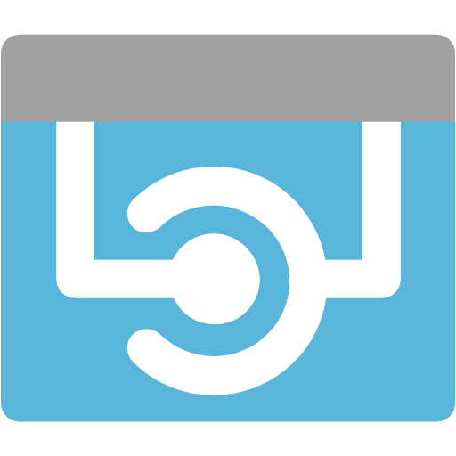
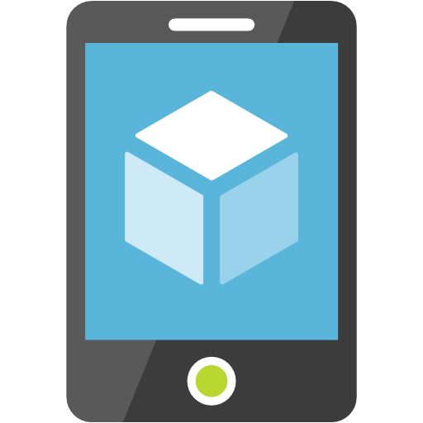
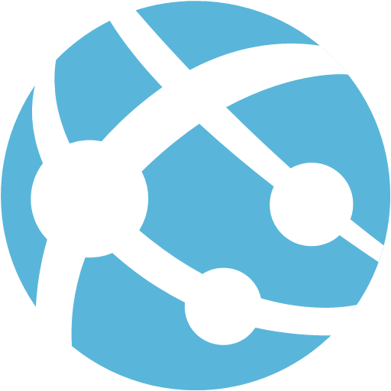
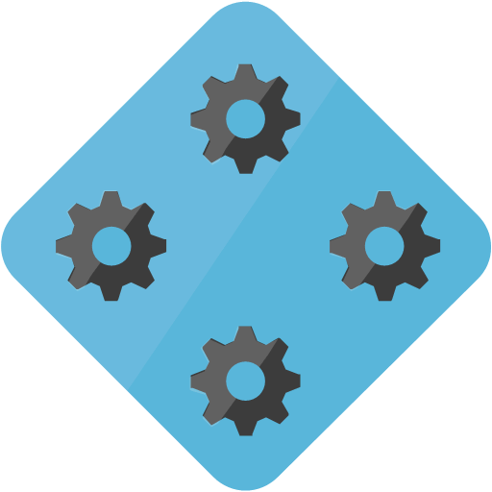
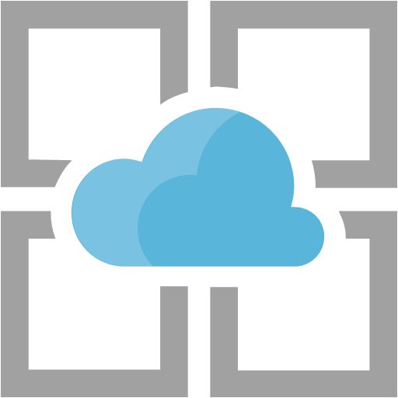
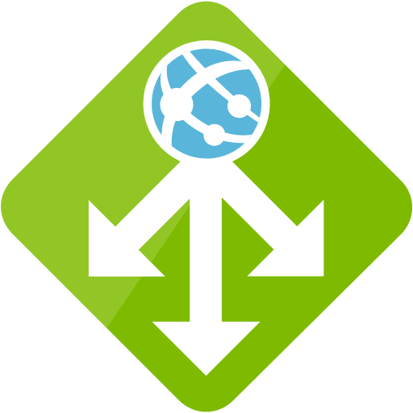
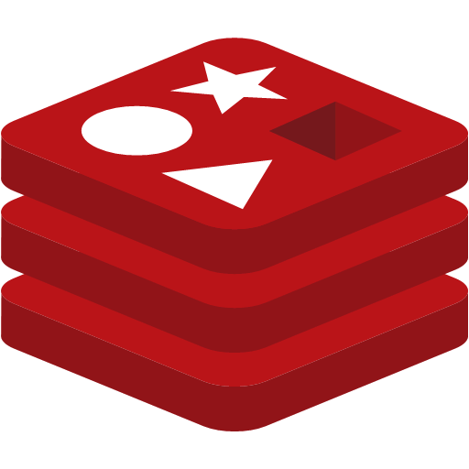

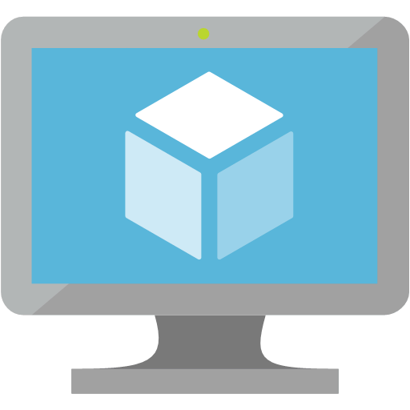
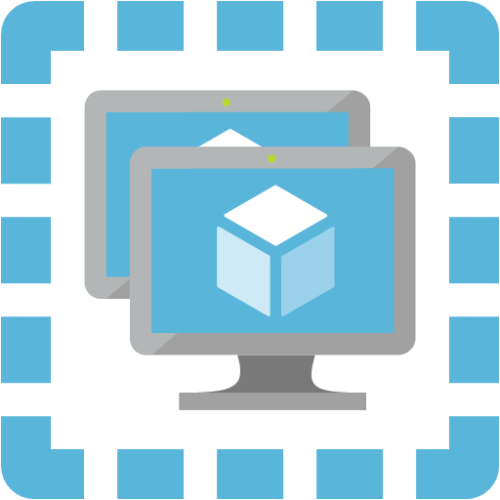
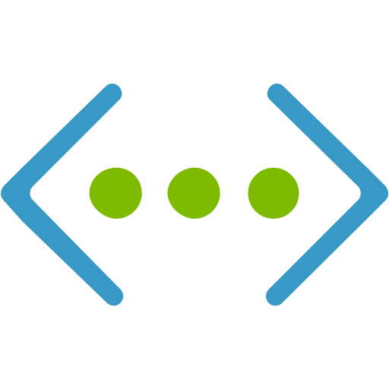
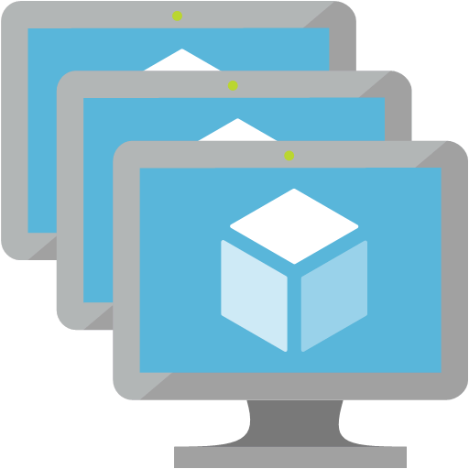

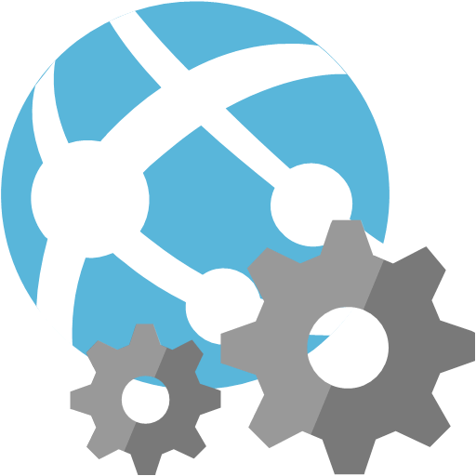
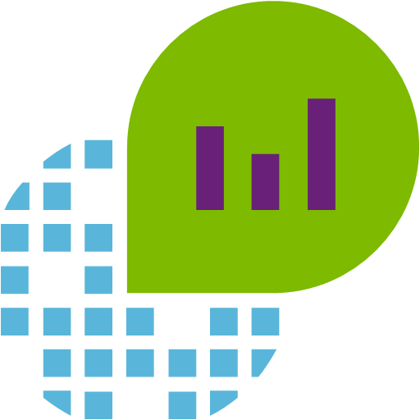
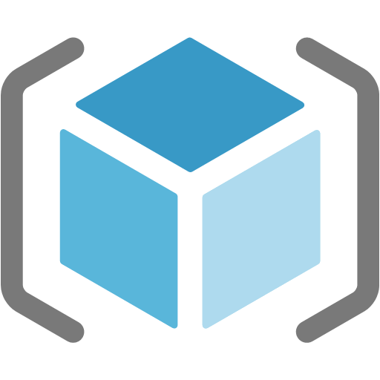
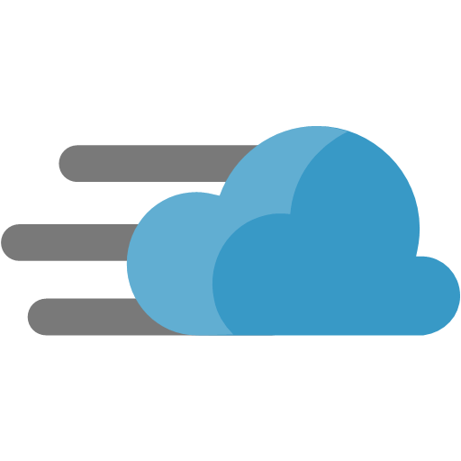


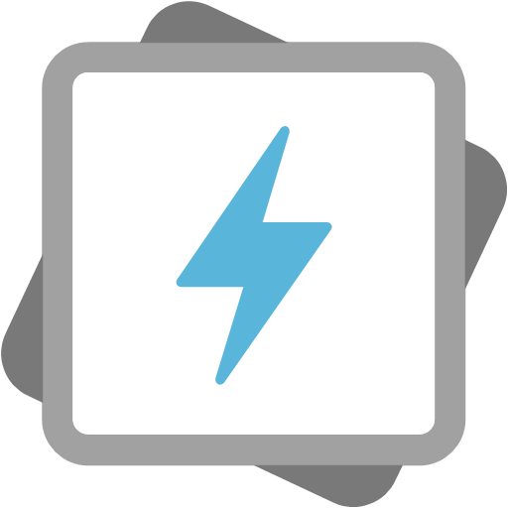

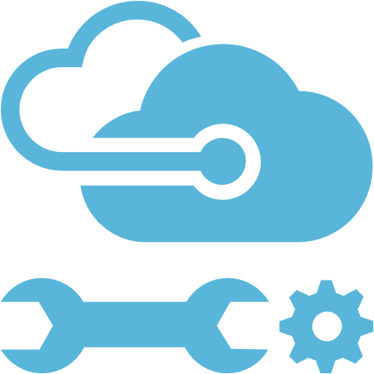

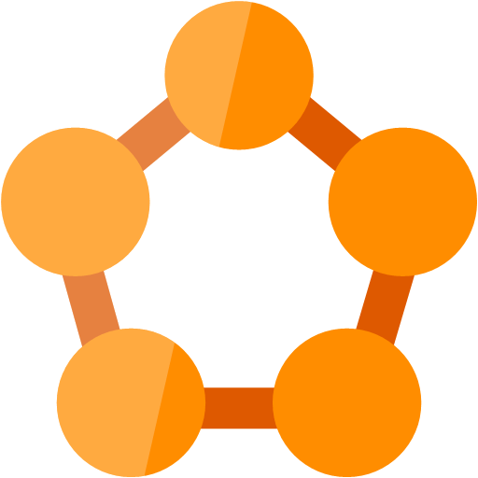
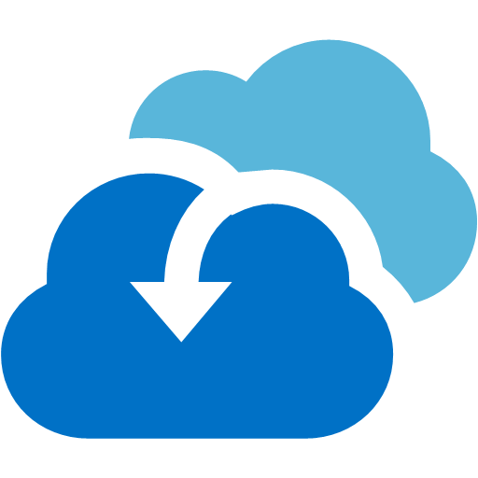
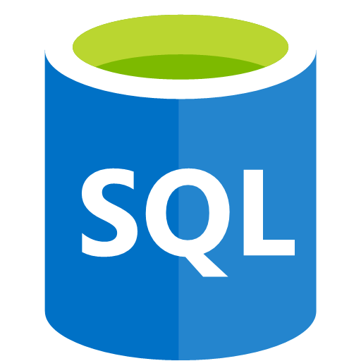
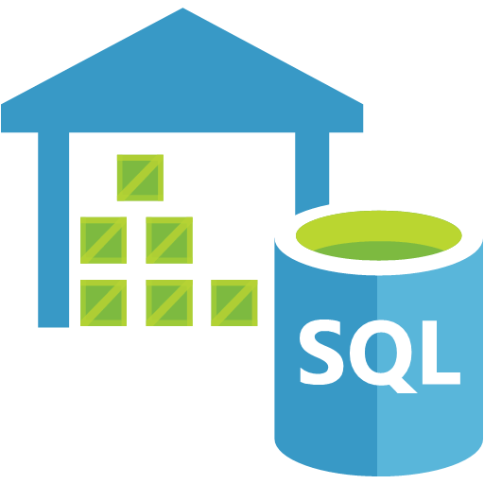
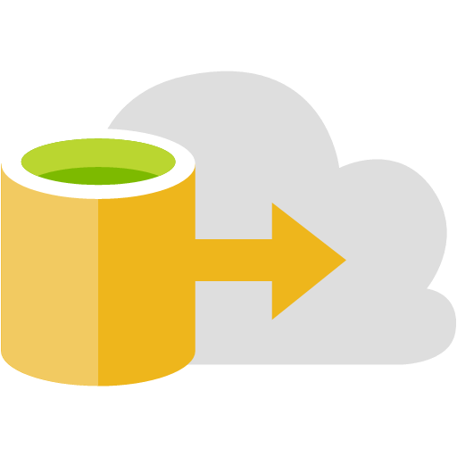
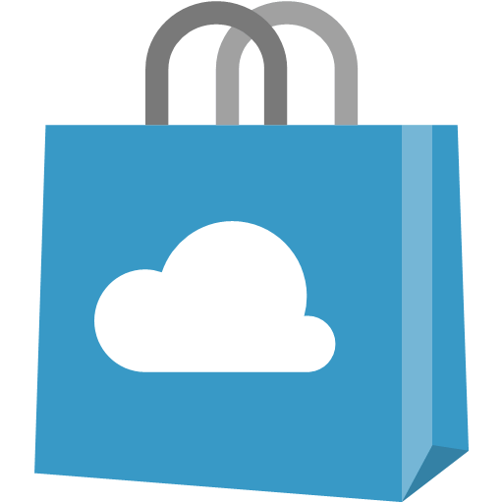
















Azure Portal

Slide 27
Azure Portal
Use Resource Groups!
IoT Hub
Devices
Azure Stream Analytics Job
IoT Hub Input
Power BI output
Service Bus Namespace
Queue
Function App
Function

